Slide 1
Sentiment Analysis of Movie Reviews using Deep Learning
Under the guidance of:
Professor. Jesus A Gonzalez
Team 10
-Suraj Kalyampudi ( 1002135272) -Sai Krishna Movva Jaya(1002119758) -Karan Vasudevamurthy ( 1002164438)

Slide 2
OBJECTIVE
Analyze the sentiment of movie reviews (positive or negative) by leveraging Deep Learning techniques.
Develop a robust model capable of:
Classifying sentiments of reviews with high accuracy.
Handling complex, context-dependent language features.
Explore key deep learning methods (RNN, LSTM, etc.) to effectively understand and predict emotional tone in text.
Assess performance using evaluation metrics such as accuracy, precision, recall, and F1-score.

Slide 3
Dataset
Kaggle : IMDB-dataset https://www.kaggle.com/datasets/lakshmi25npathi/imdb-dataset-of-50k-movie-reviews

Slide 4
Overview
DATA COLLECTION
Collecting the data from the Kaggle website
DATA ANALYSIS
Conducting Exploratory Data Analysis (EDA) on the initial dataset to gain insights into its structure, trends, and key features.
Data pre-processing
Applying data preprocessing steps to transform the dataset into the required format for model training and subsequent analysis.

Slide 5
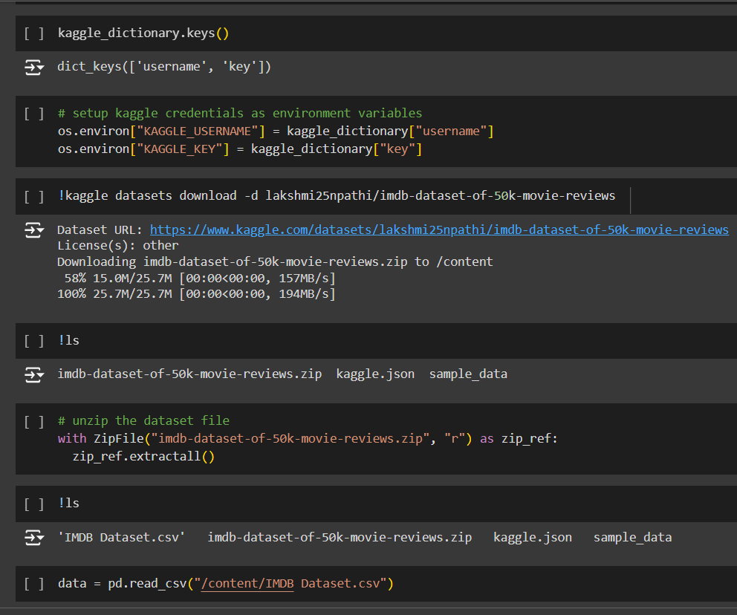
DATA COLLECTION
To collect the data, we have used the Kaggle’s API to provide secure authentication.
After we download the dataset, we have to unzip it
After unzipping it, we store the CSV file as a DataFrame
Notes:
-Data collected through the Kaggle API. - We get a .zip file, so we need to unzip it
- Then we store it in a df

Slide 6
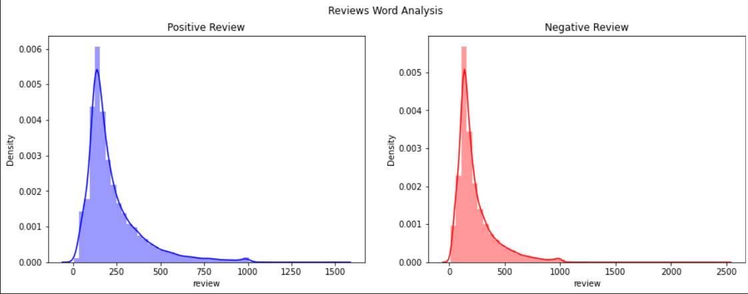
Exploratory Data Analysis

Slide 7
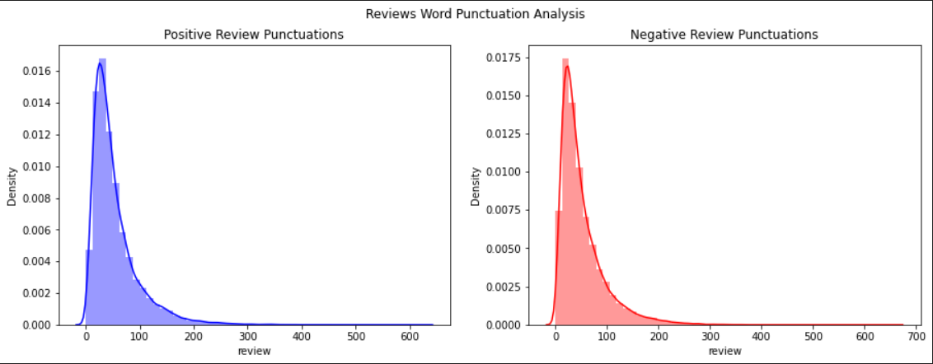
Exploratory Data Analysis

Slide 8
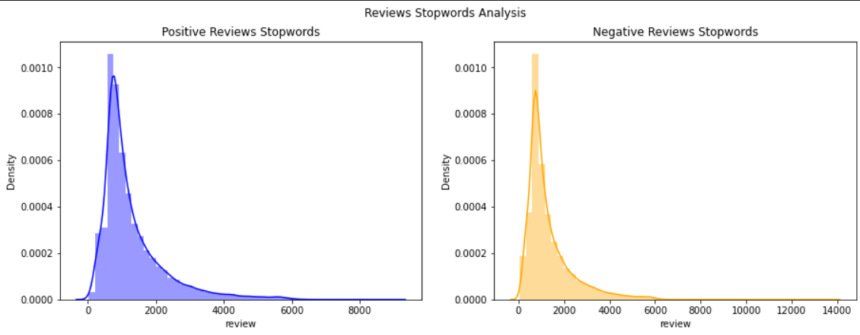
Exploratory Data Analysis

Slide 9
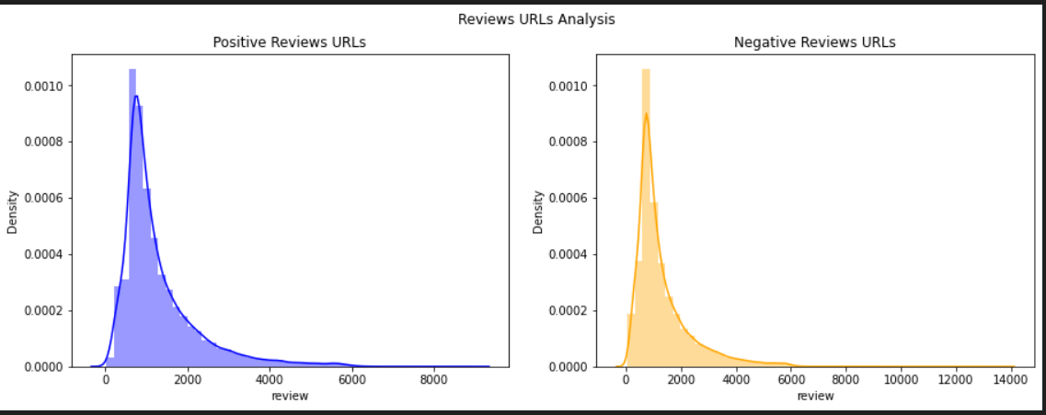
Exploratory Data Analysis

Slide 10
What does this mean?
The dataset is balanced.
The dataset contains equal number of semantics for reviews of both polarity.
The dataset contains redundant words and html syntaxes.
Punctuations/stopwords are present in a equal distribution in the dataset.

Slide 11
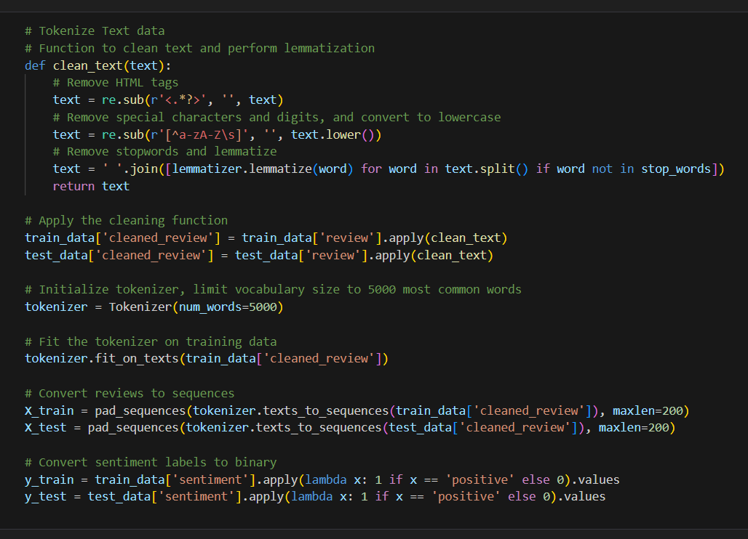
DATA PRE PROCESSING
We clean the data to remove any HTML tags and characters.
We also remove the stop words and perform Lemmatization
Reviews are then converted into sequences
Train-Test split is 80-20.

Slide 12
SUMMARY
Train and evaluate deep learning models like RNN, LSTM, and CNN for sentiment classification.
Fine-tune model hyperparameters to improve performance and accuracy.
Explore transformers to see how they perform against other deep learning models

Slide 13
THANK YOU
TEAM 10
-Suraj Kalyampudi ( 1002135272) -Sai Krishna Movva Jaya(1002119758) -Karan Vasudevamurthy ( 1002164438

